Slide 1
Oracle
New Payroll Changes
Effective January 1, 2013
Processing guidelines outlined in this handout is for the sole purpose and use for Division 1 & 2 operations serviced by the HR/PAYROLL CENTER IN STOCKTON, CA

Slide 2
What’s Changing?
You will CLOCK IN/OUT daily – (a bi-weekly timecard will be automatically created in Oracle)
For any corrections to your time card including, but not limited to, vacation, sick, or personal choice holiday, you must prepare/complete a Missed Punch/Exception Form
The Form must be sent to your Manager for approval, then it will be forwarded to HR/Payroll each day for processing by 10:00 am

Slide 3
Missing a Punch?
If you…….
Are unable to Clock In/Out
Need to correct clocking errors
Working outside the office
Need to report sick/vacation/personal choice holiday
You must…….
Prepare/complete a Missed Punch/Exception Form and send to your Manager for approval (the Form will be forwarded to HR/Payroll each day by 10:00 am)
Missed Punch/Exception Form can be located on the Clock In/Out screen

Slide 4
Rounding
Each clock punch is rounded to the minute when payroll is processed
You will not see final rounding on your timecard before payroll is submitted
You will only see final rounding after payroll is processed

Slide 5
Reviewing Timecard
You should review your timecard for accuracy every Friday BUT no later than 9:00 am on payroll Monday (see attached payroll schedule for 2013)
You can review your daily punches by clicking on “Show Punches”
The times you Clock In/Out on a daily basis is displayed on your timecard the following day
After reviewing your actual timecard in Oracle, then only CLICK on “CANCEL”(DO NOT DO ANY OTHER STEPS)-- this will complete your timecard process
HR/Payroll will complete the final steps in processing/submitting your timecard each pay period

Slide 6
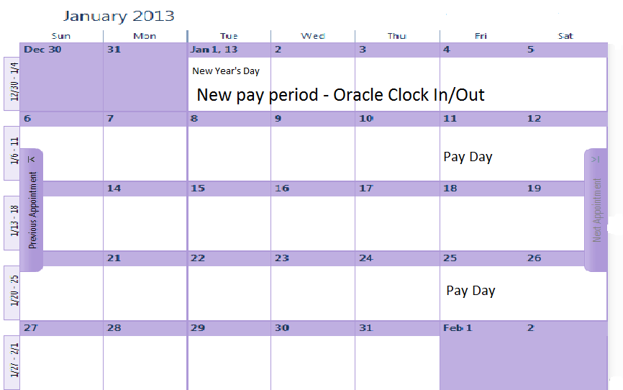
Last paycheck on paper time sheet is pay thru Monday, December 31, 2012
Any and all adjustments for December 16th thru December 31st will be processed for your January 11th paycheck
Start Clocking In/Out on Wednesday, January 2, 2013
First paycheck on Friday, January 11, 2013 – 32 hours plus exception time
Receive a paycheck every other Friday – reflecting an 80 hour pay period, starting January 25th

Slide 7
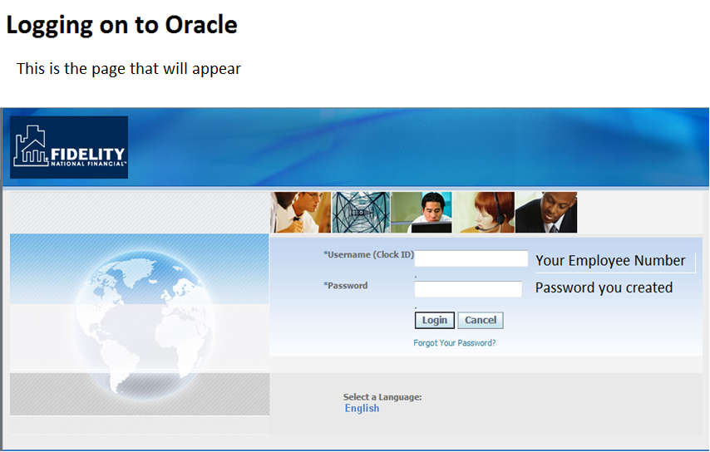

Slide 8
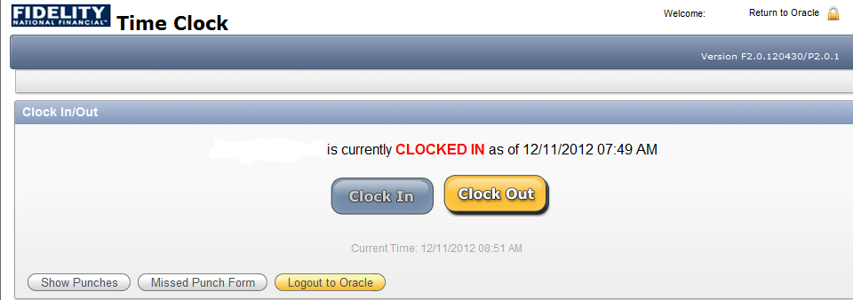
Clocking In
At the beginning of your work day:
Log on to Oracle
Click the Clock In button
You will see that you are Clocked In
Click on the “Logout to Oracle” - for security purposes, your session will be timed out
The Oracle Time Clock is not available until Tuesday, January 1st

Slide 9
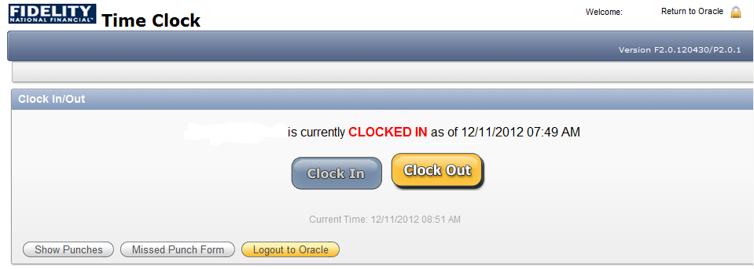
Clocking Out
Log on to Oracle
Click the Clock Out button
You will see that you are Clocked Out
Click on “Logout to Oracle” - for security purposes, your session will be timed out

Slide 10
Remember to Clock Out and In when……
Taking a lunch break
Leaving for a personal appointment – (including but not limited to, a medical visit, family obligation, etc.)

Slide 11

Connecting to VPN or Citrix
If you are a VPN or Citrix user, you must be connected to these systems to log on to Oracle when working outside the office
You can not connect to VPN or Citrix by using a smartphone

Slide 12
It is your responsibility to ensure your timecard is correct

Slide 13
2013 Bi-Weekly Payroll Schedule
Pay Period |  | Pay Period Begins | Pay Period Ends | Payroll | PAY DAY
 |  |  |  | Monday
1 |  | 12/24/12 | 01/06/13 | 1/7/2013 | 01/11/13
2 |  | 01/07/13 | 01/20/13 | 1/22/2013 ** | 01/25/13
3 |  | 01/21/13 | 02/03/13 | 2/4/2013 | 02/08/13
4 |  | 02/04/13 | 02/17/13 | 2/19/2013 ** | 02/22/13
5 |  | 02/18/13 | 03/03/13 | 3/4/2013 | 03/08/13
6 |  | 03/04/13 | 03/17/13 | 3/18/2013 | 03/22/13
7 |  | 03/18/13 | 03/31/13 | 4/1/2013 | 04/05/13
8 |  | 04/01/13 | 04/14/13 | 4/16/2013 | 04/19/13
9 |  | 04/15/13 | 04/28/13 | 4/29/2013 | 05/03/13
10 |  | 04/29/13 | 05/12/13 | 5/13/2013 | 05/17/13
11 |  | 05/13/13 | 05/26/13 | 5/27/2013 ** | 05/31/13
12 |  | 05/27/13 | 06/09/13 | 6/10/2013 | 06/14/13
13 |  | 06/10/13 | 06/23/13 | 6/24/2013 | 06/28/13
14 |  | 06/24/13 | 07/07/13 | 7/8/2013 | 07/12/13
15 |  | 07/08/13 | 07/21/13 | 7/22/2013 | 07/26/13
16 |  | 07/22/13 | 08/04/13 | 8/5/2013 | 08/09/13
17 |  | 08/05/13 | 08/18/13 | 8/19/2013 | 08/23/13
18 |  | 08/19/13 | 09/01/13 | 9/3/2013 ** | 09/06/13
19 |  | 09/02/13 | 09/15/13 | 9/16/2013 | 09/20/13
20 |  | 09/16/13 | 09/29/13 | 9/30/2013 | 10/04/13
21 |  | 09/30/13 | 10/13/13 | 10/14/2013 | 10/18/13
22 |  | 10/14/13 | 10/27/13 | 10/28/2013 | 11/01/13
23 |  | 10/28/13 | 11/10/13 | 11/11/2013 | 11/15/13
24 |  | 11/11/13 | 11/24/13 | 11/25/2013 | 11/29/13
25 |  | 11/25/13 | 12/08/13 | 12/9/2013 | 12/13/13
26 |  | 12/09/13 | 12/22/13 | 12/23/2013 | 12/27/13
 |  |  |  | **Monday falls on a holiday due on Tuesday

